Slide 1
Pulse Width Modulation
Prepared by:
Omar Samir

Slide 2
Pulse Width Modulation
PWM is a way to control analog devices with a digital output
Motors, actuators, speakers, …
PWM is not a true output analog signal
PWM fakes an analog-like result by applying power in pulses

Slide 3
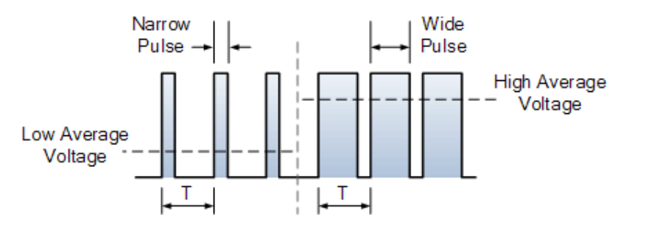
PWM Characteristics
A PWM signal is characterized by:
Duty Cycle: The percentage of high voltage in a period T
Frequency: Depends on the application
Average voltage = Duty Cycle x High voltage level

Slide 4
PWM Generation in STM32F40xxx
PWM signals are generated using the MCU timers
Our STM32F407VG has a total of 14 timers as follows:
2 advanced timers: (TIM1, TIM8)
10 general purpose timers: (TIM2, 3, 4, 5, 9, 10, 11, 12, 13, 14)
2 basic timers: (TIM6, TIM7)
Except basic timers, All other timers can be used to generate PWM output
Each timer has a number of independent channel to be used

Slide 5
PWM Generation in STM32F40xxx
PWM channels are not dedicated to fixed GPIO port pins
Timer type | Timer | Number of independent channels
Advanced | 1, 8 | 4
General Purpose | 2, 3, 4, 5 | 4
 | 9, 12 | 2
 | 10, 11, 13, 14 | 1

Slide 6
MikroC PWM Library
Facilitates the use of timers for PWM generation
Can be included as we included the Button library before
Has mainly four functions to deal with timers for PWM
PWM_TIMn_Init
PWM_TIMn_Set_Duty
PWM_TIMn_Start
PWM_TIMn_Stop

Slide 7
MikroC PWM Library
unsigned int PWM_TIMn_Init(unsigned long freq_hz);
Initializes timer n in PWM mode
Takes as input the PWM frequency in Hz
Returns the calculated timer period
Example:
unsigned int period = 0;
period = PWM_TIM1_Init(25000); // initializes timer 1 in PWM mode with 25 kHz frequency

Slide 8
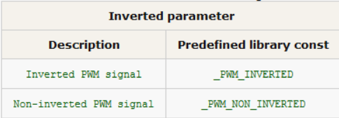
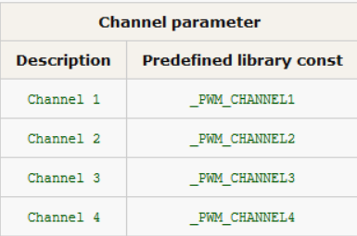
MikroC PWM Library
void PWM_TIMn_Set_Duty(unsigned int duty, char inverted, char channel);
Changes duty ratio for Timer module in PWM mode for ST MCUs.
Inputs:
duty: PWM duty ratio, takes values from 0 to timer period returned by PWM_TIMn_Init
inverted: inverted and non inverted PWM signals
channel: desired PWM channel
Example:
// sets timer 8 duty ratio to 200, non inverted signal, channel 4
PWM_TIM8_Set_Duty(200, _PWM_NON_INVERTED, _PWM_CHANNEL4);

Slide 9
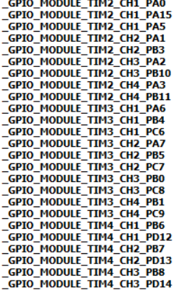
MikroC PWM Library
void PWM_TIMn_Start(char channel, const module_Struct *module);
Starts Timer n in PWM mode
Inputs:
channel: desired PWM channel
module: mapping the channel to a GPIO port pin
Example:
// starts timer 3 PWM generation to channel 2 and maps the output to PC7
PWM_TIM3_Start(_PWM_CHANNEL2, &_GPIO_MODULE_TIM3_CH2_PC7);

Slide 10
MikroC PWM Library
void PWM_TIMn_Stop(char channel);
Stops timer n in PWM mode
Takes channel as input
Example:
// stops timer 4 channel 1 from generating PWM output
PWM_TIM4_Stop(_PWM_CHANNEL1);

Slide 11
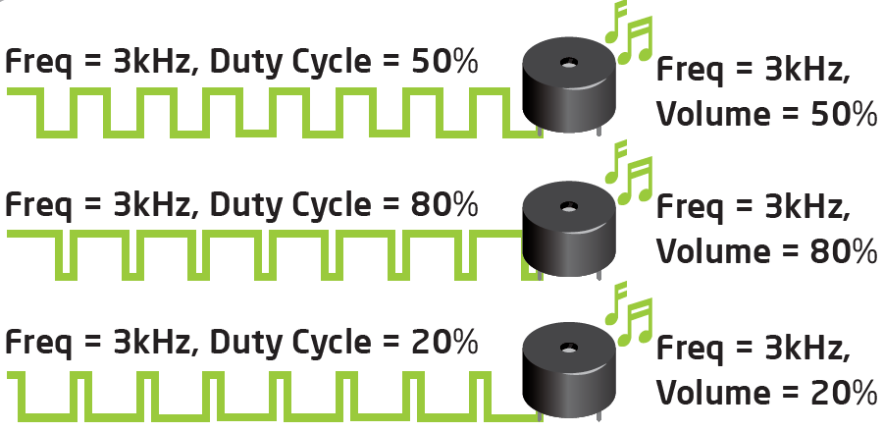
EasyMx Pro Buzzer
Create sound when provided analog signal
Connected to pin PE14
Can be used by generating PWM output to PE14

Slide 12
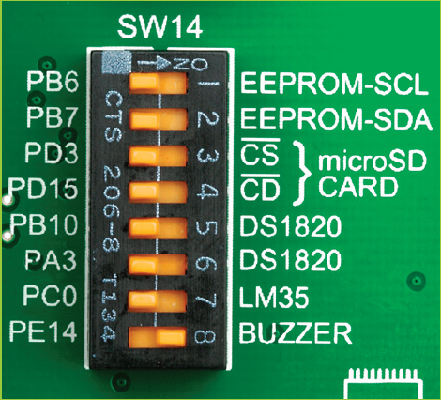
Enable the Buzzer
To enable the Buzzer you need to push SW14.8 to ON position

Slide 13
Requirements

Slide 14
Requirement 1
It is required to to generate a fixed non inverted 500 Hz PWM signal with 20% duty ratio on PE14 and enable the Buzzer.
Hints:
Don’t forget to include the PWM library from library manager
To find out what timer and channel to work with you can use code assistant
Type _GPIO_MODULE_TIM
Press CTRL + SPACE
Search for PE14

Slide 15
Requirement 2
It is required to fade PE14 LED ( and hence the Buzzer). Use timer 1 to output a 3.8 kHz PWM signal with a duty ration that goes from 0 to 100% then from 100% to zero and so on.
Hint:
Use Delay_us(time_in_microseconds) in your loop.

Slide 16
Requirement 3
It is required to use timer 4 to generate 4 kHz PWM signals. Use the 4 channels of timer 4 and map them to PD12, PD13, PD14, PD15. The LEDs should fade from OFF to ON sequentially then from ON to OFF in the same order and so on.

